Slide 1
Week 8
CRUD Commands (OFFSET & FETCH, UPDATE & ROLLBACK)

Slide 2
Course plan
Review (Midterm Exam)
Update & Rollback command
2 short videos
Smart Table Design
Assignment

Slide 3
Review
Database, Table, Row, Column, SSMS Installation, Restoring Databases.
NULL values, Keys (Primary, Candidate, Foreign, …), SELECT … FROM … WHERE … ORDER BY, Comments, PRINT, USE, NOT, AND, OR.
DATE Functions (GetDate, DatePart, DateAdd, DateDiff), IS NULL, IN, BETWEEN, LIKE, Cast
Joins (INNER, OUTER ( Right, Left and Full), CROSS), Tables’ Relationship
Sub-Query, Scalar Functions (Min, Max, Sum, AVG, Count), Group By, CTE (Common Table Expression)
CRUD commands (Create, Update, Insert Into, and Delete), Backup tables, Truncate, Declare, GO, Drop.

Slide 4
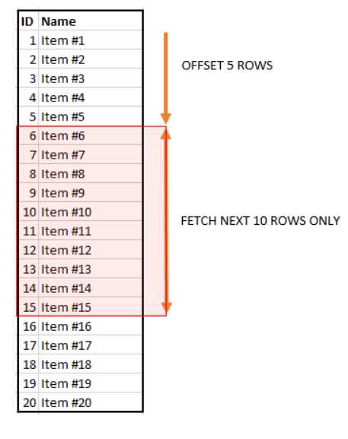
OFFSET & FETCH
SELECT column-names
FROM table-name
ORDER BY column-names
OFFSET n ROWS
FETCH NEXT m ROWS ONLY
OFFSET and FETCH Clause are used in conjunction with SELECT and ORDER BY clause to provide a means to retrieve a range of records.
The OFFSET argument is used to identify the starting point to return rows from a result set. Basically, it exclude the first set of records.
Note:
OFFSET can only be used with ORDER BY clause. It cannot be used on its own.
OFFSET value must be greater than or equal to zero. It cannot be negative, else return error.

Slide 5
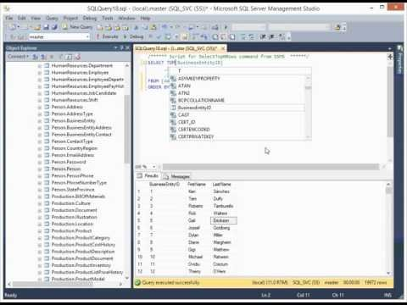
SQL Server Tutorial 1 - Offset and Fetch

Slide 6
UPDATE
Reminder:
The UPDATE command allows you to change the value of one or more columns in one or more rows of a table.
Adding a value to a column that is currently NULL and removing a value from a column are both considered UPDATE statements, not INSERT or DELETE statements.

Slide 7
UPDATE (Reminder)
UPDATE statement has the ability to update all rows in a table with a single command
The following command adds 0.005 to EndOfDayRate column in every row in the CurrencyRate table
UPDATE Sales.CurrencyRate
SET EndOfDayRate = EndOfDayRate + .05;
Test the query. How to undo the changes?

Slide 8
UPDATE (Reminder)
Using UPDATE with WHERE clause:
UPDATE Sales.SalesReason
SET Name = 'N/A'
WHERE SalesReasonID = 10;

Slide 9
UPDATE
You can update the information in a target table based on information in a table joined to the target table by using the FROM clause.
To increases the unit price of all red products by 5 percent:
UPDATE Sales.SalesOrderDetail
SET UnitPrice = UnitPrice * 1.05
FROM SALES.SalesOrderDetail
INNER JOIN Production.Product
ON SALES.SalesOrderDetail.ProductID = Production.Product.ProductID
WHERE Production.Product.Color = 'Red'

Slide 10
UPDATE
Change data just in case the incorrect values were inserted, using the already inserted data.
We need to add ‘Europe’ to all the names of departments.
SELECT *
FROM HumanResources.Department;
Use it to see the data in the table
USE AdventureWorks2014; UPDATE HumanResources.Department SET Name = Name +' Europe' WHERE DepartmentID = 19
Execute the command
There is no DepartmentID = 19, and nothing will be changed.
(0 row(s) affected)
It is better NOT to use UPDATE command like this, or there will be a chance to change the data incorrectly (or more than once). See the next slide.

Slide 11
UPDATE
As a precaution, It is better to add an additional filter to the WHERE clause to ensure that the UPDATE statement is not repeatable.
In other words, if the query was accidently run twice, it would have no effect on the data.
This is especially important when performing a concatenation or math­ematical change.
UPDATE HumanResources.Department
SET Name = Name +' Europe'
WHERE DepartmentID = 19
AND NAME NOT LIKE '% Europe';

Slide 12
Exercise (Do it at home)
Using slide #5 and UPDATE command, use this query to update the list price of all items in the socks sub category. Adjust the items in this category by increasing the prices by 5 percent.
SELECT p.ListPrice,p.ProductID, ps.Name, ps.ProductSubcategoryID
FROM Production.Product p
INNER JOIN Production.ProductSubcategory ps
ON p.ProductSubcategoryID = ps.ProductSubcategoryID;

Slide 13
ROLLBACK TRANSACTION
Rolls back a transaction to the beginning of the transaction, or to a savepoint inside the transaction.
You can use ROLLBACK TRANSACTION to erase all data modifications made from the start of the transaction or to a savepoint.
BEGIN TRANSACTION or TRAN
…
ROLLBACK
Use them when you are not sure about a transaction.

Slide 14
Updating multiple columns
The following example updates the values in the Bonus, CommissionPct, and SalesQuota columns for all rows in the SalesPerson table.
-- Look at the table’s data
SELECT Bonus, CommissionPct, SalesQuota
FROM Sales.SalesPerson;
-- Do not forget to add a start point
Begin Transaction;
-- Update your table
UPDATE Sales.SalesPerson
SET Bonus = 6000, CommissionPct = .10, SalesQuota = NULL;
-- Look at your data again
SELECT Bonus, CommissionPct, SalesQuota
FROM Sales.SalesPerson;
-- rollback before the beginning point
rollback;
-- Look at your data again
SELECT Bonus, CommissionPct, SalesQuota
FROM Sales.SalesPerson;

Slide 15
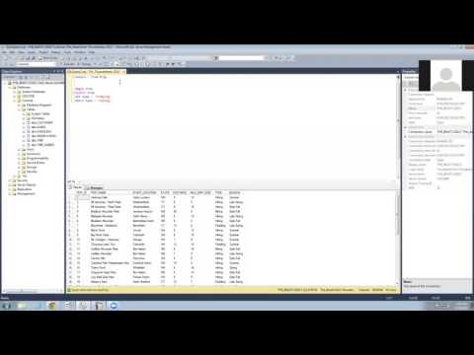
Duration: 3 minutes

Slide 16
Using the WHERE clause
The following example uses the WHERE clause to specify which rows to update.
The statement updates the value in the Color column of the Production.Product table for all rows that have an existing value of 'Red' in the Color column and have a value in the Name column that starts with 'Road-250'.
Begin Transaction;
GO
UPDATE Production.Product
SET Color = N'Metallic Red'
WHERE Name LIKE N'Road-250%' AND Color = N'Red';
Undo the changes afterwards
Group Discussion.
What is N before the strings?
Use the online sources to find the answer. You must add it to your assignments’ queries in future.

Slide 17
Using the TOP clause in UPDATE
Use the TOP clause to limit the number of rows that are modified in an UPDATE statement.
SELECT TOP 15 [BusinessEntityID], [VacationHours]
FROM [HumanResources].[Employee];
When a TOP (n) clause is used with UPDATE, the update operation is performed on a random selection of 'n' number of rows. The following example updates the VacationHours column by 25 percent for 10 random rows in the Employee table.
Do NOT forget to use ROLLBACK.
UPDATE TOP (10) HumanResources.Employee
SET VacationHours = VacationHours * 1.25;

Slide 18
In-Class exercise
Read the query carefully and discuss about it with your classmates.
You can execute the command but do not forget to use safe mode (BEGIN TRANSACTION and ROLLBACK).
UPDATE HumanResources.Employee
SET VacationHours = VacationHours + 8
FROM (SELECT TOP 10 BusinessEntityID
FROM HumanResources.Employee
ORDER BY HireDate ASC) AS th
WHERE HumanResources.Employee.BusinessEntityID = th.BusinessEntityID;

Slide 19
Specifying a compound operator
The following example uses the variable @NewPrice to increment the price of all red bicycles by taking the current price and adding 10 to it.
DECLARE @NewPrice int = 10;
UPDATE Production.Product
SET ListPrice += @NewPrice
WHERE Color = N'Red';
Using a compound operation to append the data to the existing value in a column.
Do NOT forget to use ROLLBACK.
UPDATE Production.ScrapReason
SET Name += ' - tool malfunction'
WHERE ScrapReasonID BETWEEN 10 and 12;

Slide 20
Updating rows using DEFAULT value
The following example sets the CostRate column to its default value (0.00) for all rows that have a CostRate value greater than 20.00.
UPDATE Production.Location
SET CostRate = DEFAULT
WHERE CostRate > 20.00;
Do NOT forget to use ROLLBACK.

Slide 21
Questions?

Slide 22
Extra Information
DBCC OPENTRAN: DBCC OPENTRAN helps to identify active transactions that may be preventing log truncation.
CREATE TABLE T1
(Col1 int,
Col2 char(3));
GO
BEGIN TRAN
INSERT INTO T1
VALUES (101, 'abc');
GO
DBCC OPENTRAN;
ROLLBACK TRAN;
GO DROP TABLE T1;
GO

